Slide 1
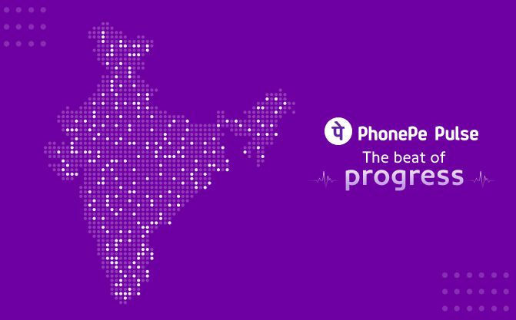
PhonePe Pulse Analysis

Slide 2
Problem Statements:
The Phonepe pulse Github repository contains a large amount of data related to various metrics and statistics. The goal is process the data to obtain insight and information that can be visualized in a user-friendly manner.
Following two process has been done and data is transformed as a valuable and the same data is given to you
Extracting the data from the Phonepe pulse Github repository through scripting and clone it.
2) Transforming the data into a suitable format and perform any necessary cleaning and pre-processing steps.

Slide 3
The solution must include the following steps:
1) Create a live geo visualization dashboard using tableau or Power-BI in an interactive and visually appealing manner.
2) Provide at least 10 different dropdown options for users to select different facts and figures to display on the dashboard.
The solution must be secure, efficient, and user-friendly. The dashboard must be easily accessible and provide valuable insights and information about the data in the Phonepe pulse Github repository.

Slide 4
Approach:
1) Merge all the files that is obtained from the phonepe data which is already preprocessed and provided.
2) Choose your platform: Decide whether to use Tableau or Power BI. Both platforms are excellent for creating geo visualizations, and it comes down to personal preference and familiarity.
3) Import data: Import the PhonePe Pulse data into your chosen platform.
4) Create a geo map: Create a basic geo map using your imported data. This will help you understand the distribution of your data and provide insights for more advanced visualizations.

Slide 5
5) Add layers: Layer on additional information such as demographics, transaction value. This will help you to identify trends and draw insights.
6) Design your dashboard: Customize your dashboard layout to suit your objective and audience. Ensure that your visualizations are clear, concise and easy to interpret.
7) Provide at least 10 different dropdown options for users to select different facts and figures to display on the dashboard.
8) Create the growth rate and KPI to identify the trends and to track the success of business firms.
9) Analyze the visualization dashboards and provide insights from the visualizations. This approach leverages the use of Power-BI or Tableau to create a user-friendly dashboard for visualizing the insights obtained from the data.

Slide 6
Results:
The result of this project will be a live geovisualization dashboard that displays information and insights from the Phonepe pulse Github repository in an interactive and visually appealing manner. The dashboard will have at least 10 different dropdown options for users to select different facts and figures to display. The dashboard will provide valuable insights and information about the data in the Phonepe pulse Github repository, making it a valuable tool for data analysis and decision-making.

Slide 7
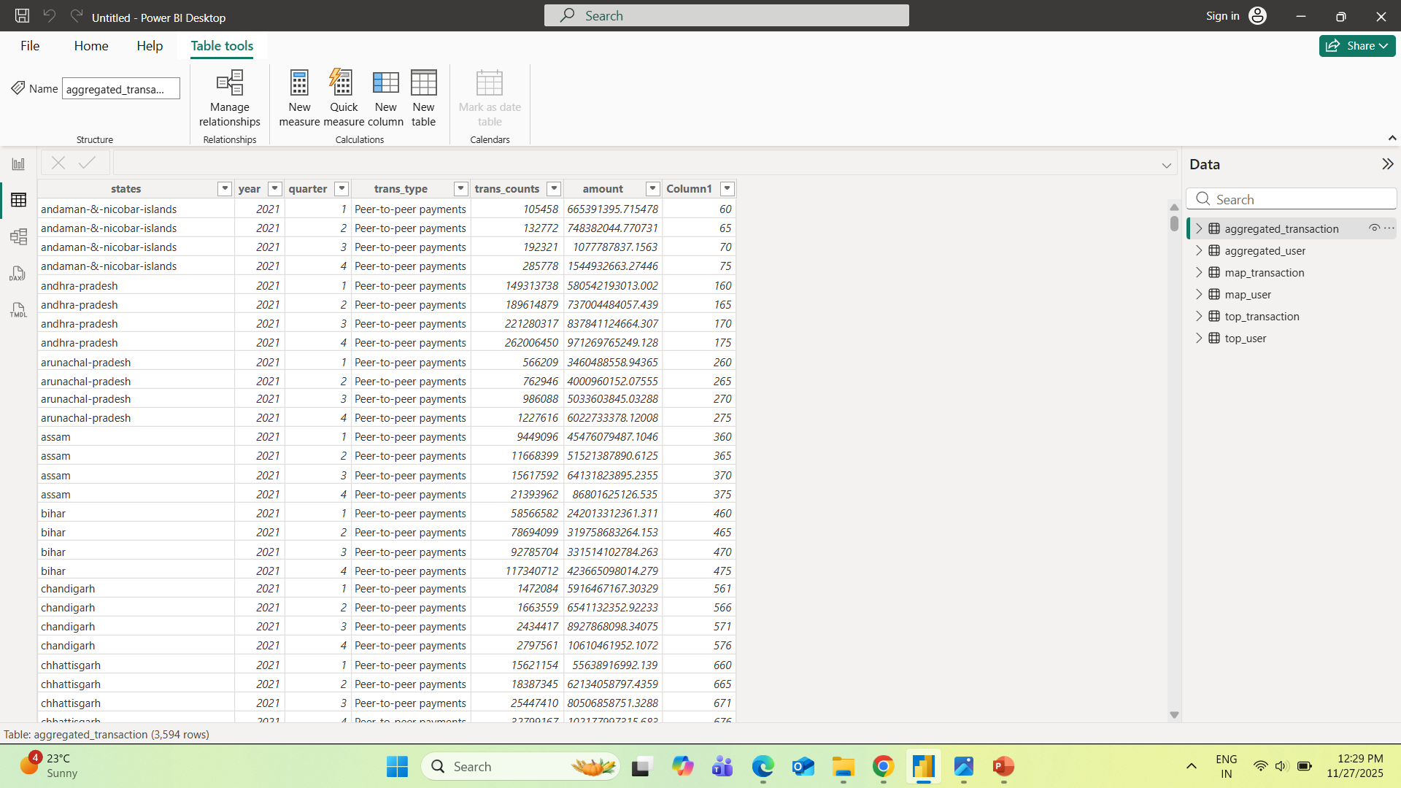
Dataset:

Slide 8
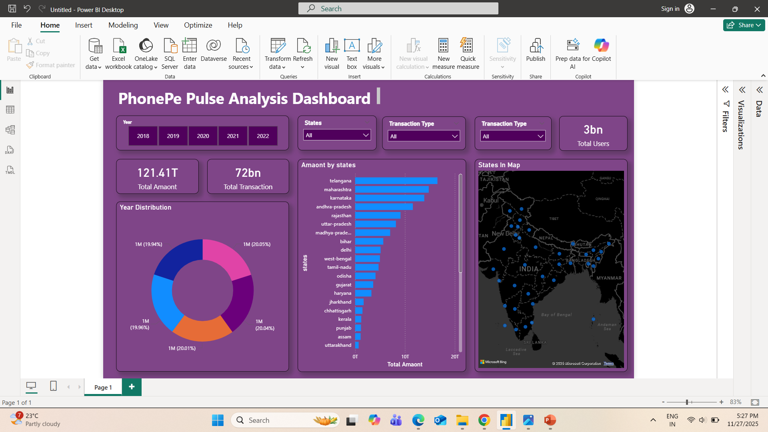
PhonePe Dashboard:

Slide 9
PhonePe Dashboard Insights:
Key Insights from the PhonePe Pulse Dashboard
Strong Growth Across Years
The dashboard shows filters for 2018–2022, and the pie (donut) chart indicates that each year contributes almost equally (19–20%).
This suggests:
  Consistent growth in digital payments year over year.
  No major dip in usage—indicating steady adoption of UPI across India.

Slide 10
Massive Total Transactions
₹121.41 Trillion total amount transacted.
72 Billion total transactions.
This highlights:
  Extremely high engagement on PhonePe.
  India’s rapid shift toward cashless payments.
  Strong transaction density despite a relatively short timeframe (5 years).

Slide 11
State-Wise Performance (Top Contributors)
The bar chart makes it clear that a few states dominate UPI usage:
Top Performing States by Transaction Amount:
Telangana – highest transaction value
Maharashtra
Karnataka
Andhra Pradesh
Rajasthan
Observations:
Southern and Western states lead digital payment adoption.
Telangana’s top position suggests high digital literacy and strong urban transaction volume (Hyderabad influence).
Maharashtra and Karnataka follow, driven by large metro cities like Mumbai and Bengaluru.

Slide 12
Overall Summary:
. Huge transaction volumes (₹121T) and 72B transactions show PhonePe’s leadership in the Indian UPI ecosystem.
South and West India are the strongest contributors.
Even yearly distribution reflects strong and steady adoption.
Geographic data shows mass adoption nationwide, with urban clusters showing the highest density.
Opportunities for expansion lie in Northeastern, Northern hill states, and parts of East India.

Slide 13
Thank You

